Slide 1

HEALTH
MONITORING
Project done by Ms. Niyati Sharma
Under the guidance of Mr.Deepak Makariya

Slide 2

COMPONENTS
SENSOR : MAX30100 PULSE OXIMETER
MICROCONTROLLER : ESP8266
JUMPER WIRES

Slide 3

APPS AND PLATFORMS
1.BLYNK IOT APP
Blynk is a low-code IoT software platform that allows businesses and developers to build and manage connected electronic devices with no code, using a unified suite of IoT software and cloud services ¹. It offers a fully integrated suite of IoT software that includes device provisioning, sensor data visualization, remote control with mobile and web applications, Over-The-Air firmware updates, secure cloud, data analytics, user and access management, alerts, automations, and much more ¹.
2. ARDUINO IDE
The arduino software (IDE) is an open source software, which is used to programme the Arduino boards, and is an integrated development environment, developed by arduino.cc. Allow to write and upload code to arduino boards. And it consist of many libraries and a set of examples of mini projects.
arduino software (IDE) is compatible with different operating systems (Windows, Linux, Mac OS X), and supports the programming languages (C/C++)

Slide 4

PROJECT DESCRIPTION
The advancement of wearable health monitoring devices has revolutionized the healthcare industry, enabling individuals to monitor their vital signs conveniently and continuously. This project aims to develop a health monitoring device utilizing the MAX30100 sensor for accurate measurement of vital signs such as heart rate and blood oxygen saturation. Additionally, the device will integrate with the Blynk application, allowing users to remotely monitor their health parameters in real-time.
Objective:
The primary objective of this project is to design and develop a portable health monitoring device capable of accurately measuring heart rate and blood oxygen saturation levels. Additionally, the device will be integrated with the Blynk app to enable remote monitoring and data visualization.

Slide 5
Components:
1. MAX30100 Sensor: A highly integrated pulse oximeter and heart rate sensor module for accurate monitoring of physiological parameters.
2. Microcontroller (Esp8266): To interface with the MAX30100 sensor and process the acquired data.
3. Blynk Application: A platform for building IoT applications that will facilitate remote monitoring and control of the health monitoring device.
Functionality:
1. Vital Sign Measurement: The MAX30100 sensor will continuously monitor the user's heart rate and blood oxygen saturation levels.
2. Data Processing: The microcontroller will process the raw data from the sensor to calculate accurate heart rate and blood oxygen saturation readings.
3. Data Transmission: Processed data will be sent wirelessly to the Blynk app via Wi-Fi or Bluetooth connectivity.
4. Blynk Integration: The Blynk app will receive the data and display real-time updates of the user's vital signs on a user-friendly interface.

Slide 6
Project Implementation:
1. Hardware Setup: Connect the MAX30100 sensor to the microcontroller and power source according to the datasheet specifications.
2. Software Development: Write firmware for the microcontroller to interface with the MAX30100 sensor, process data, and establish communication with the Blynk app using appropriate libraries and protocols.
3. Blynk App Configuration: Create a Blynk project and design the user interface to visualize the vital sign data received from the health monitoring device.
4. Testing and Calibration: Validate the accuracy of vital sign measurements through comparison with standard medical devices. Calibrate the system if necessary to ensure reliable performance.
5. Deployment: Assemble the components into a portable device enclosure, ensuring user comfort and ease of use. Test the device in real-world scenarios to verify functionality and reliability.
Conclusion:
By integrating the MAX30100 sensor with the Blynk application, this project aims to provide users with a convenient and reliable solution for continuous health monitoring. The ability to remotely monitor vital signs in real-time enhances accessibility and enables proactive healthcare management. This project holds significant potential for applications in personal health monitoring, telemedicine, and remote patient care.

Slide 7
CODE
#include <Wire.h>
#include <Adafruit_GFX.h>
#include <Adafruit_SSD1306.h>
#include <ESP8266WiFi.h>
#include <BlynkSimpleEsp8266.h>
#include "MAX30100_PulseOximeter.h"
#include <ESP8266WiFi.h>
#include <BlynkSimpleEsp8266.h>
#define BLYNK_TEMPLATE_ID “XXXXXXXX"
#define BLYNK_TEMPLATE_NAME “XXXXXXXX"
char auth[] = “XXXXXXXXX";
/* WiFi credentials */
char ssid[] = “XXXXXXX";
char pass[] = “XXXXXX";
#define REPORTING_PERIOD_MS 3000
PulseOximeter pox;
uint32_t tsLastReport = 0;
void onBeatDetected()
{
;
}
void loop()
{
// Initiates SimpleTimer
Blynk.run();
// Make sure to call update as fast as possible
pox.update();
if (millis() - tsLastReport > REPORTING_PERIOD_MS) {
Serial.print("BPM: ");
Serial.print(pox.getHeartRate());
//blue.println("\n");
Serial.print(" SpO2: ");
Serial.print(pox.getSpO2());
Serial.print("%");
Serial.println("\n");
Blynk.virtualWrite(V2,pox.getHeartRate() );
Blynk.virtualWrite(V3,pox.getSpO2());
tsLastReport = millis();
}
}
void setup()
{
Serial.begin(115200);
Blynk.begin(auth, ssid, pass);
Serial.print("Initializing pulse oximeter..");
if (!pox.begin()) {
Serial.println("FAILED");
for(;;);
} else {
Serial.println("SUCCESS");
digitalWrite(1,HIGH);
}
pox.setIRLedCurrent(MAX30100_LED_CURR_24MA);
// Register a callback for the beat detection
pox.setOnBeatDetectedCallback(onBeatDetected);
}

Slide 8
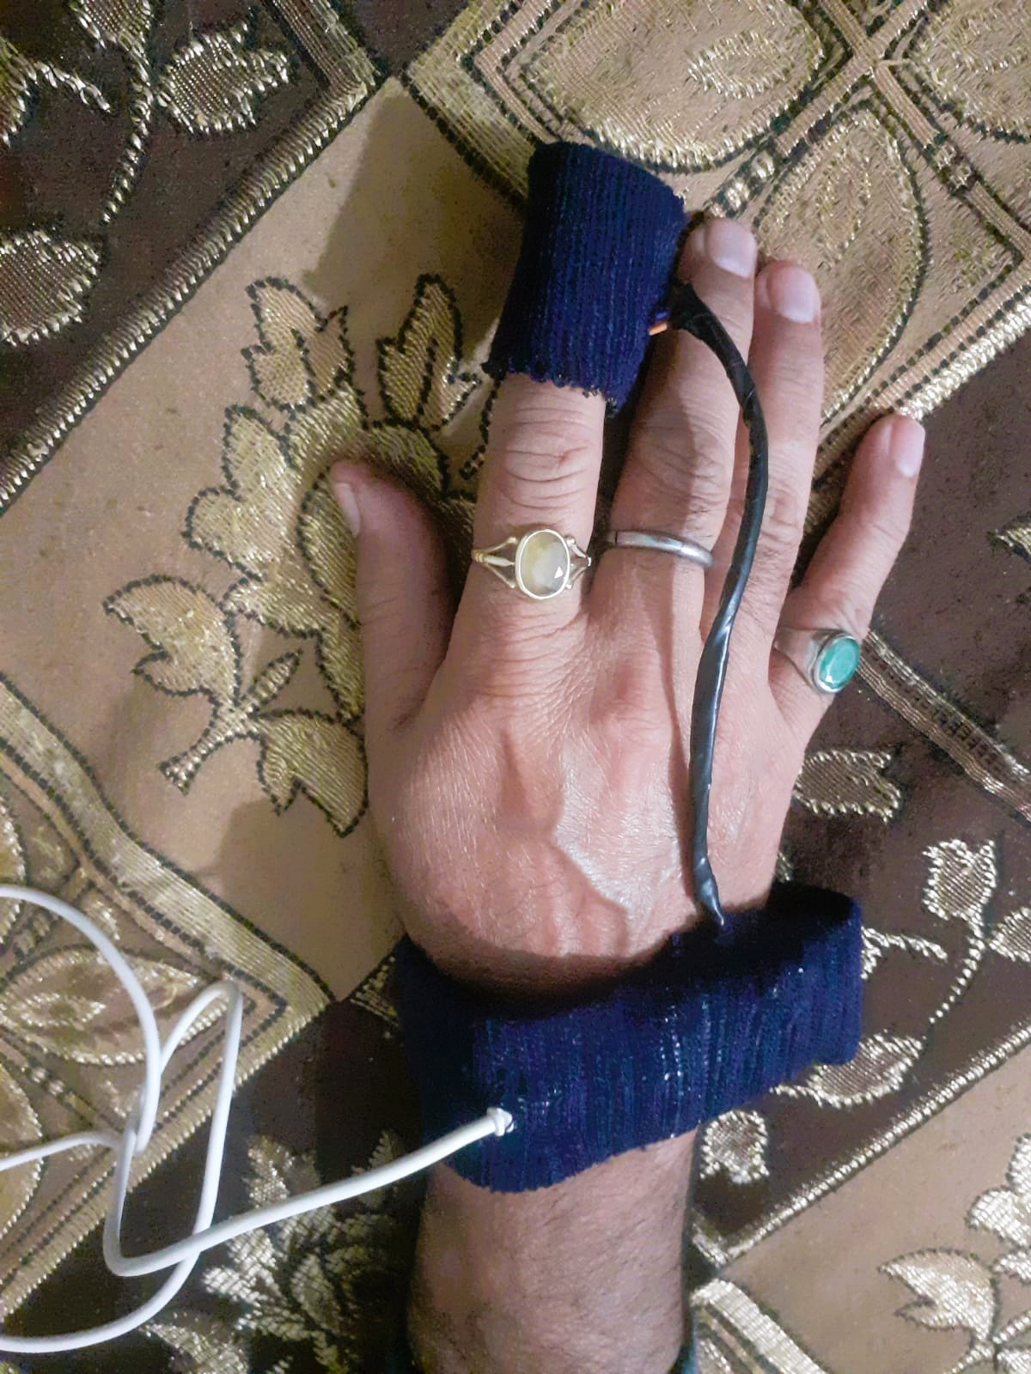
FINAL OUTPUT

Slide 9
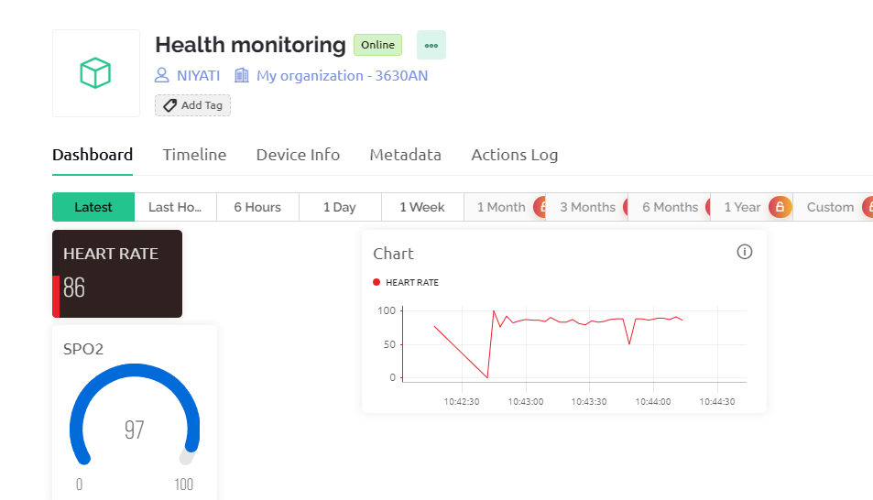
WEB DASHBOARD

Slide 10
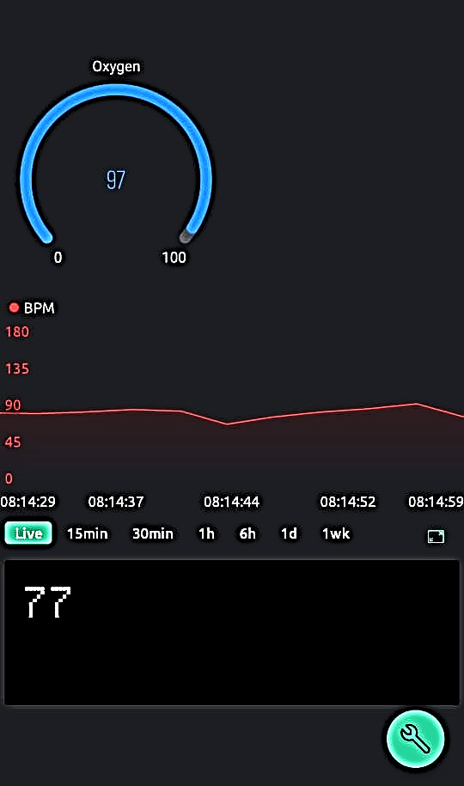
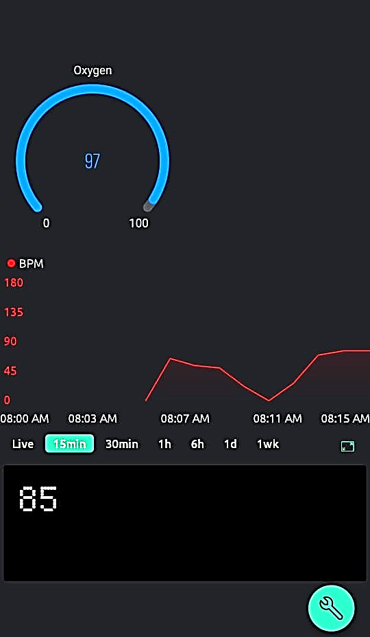
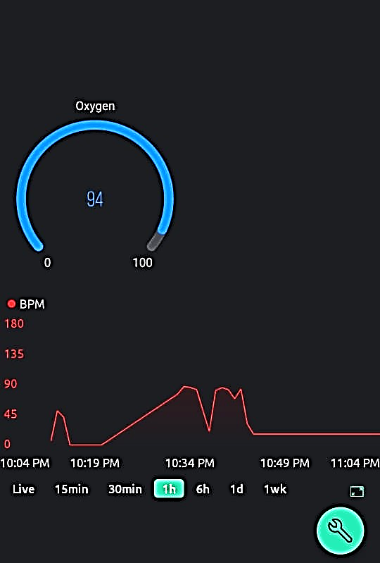
MOBILE DASHBOARD
Live Data Data of last 15 mins Data of last 1hr

